Slide 1
Chapter 14
System Testing

Slide 2
System Testing
Threads ( = a system level test cases)
Basis concepts of requirements specification
Identifying threads
Metrics for system testing

Slide 3
Various Views of Threads
a scenario of normal usage
a Use Case
a system level test case
a stimulus/response pair
behavior that results from a sequence of system level inputs
an interleaved sequence of port input and output events
a sequence of transitions in a state machine description of the system
an interleaved sequence of object messages and method executions
a sequence of machine instructions
a sequence of source instructions
a sequence of atomic system functions

Slide 4
Some Observations
Threads are “dynamic”
Threads occur at execution time
Threads can be identified in (or even better: derived from) many models
Finite state machines
Decision tables
Statecharts
Petri nets
Use Cases (sufficiently detailed)

Slide 5
Candidate Threads in the Simple ATM System
Entry of a digit
Entry of a Personal Identification Number (PIN)
A simple transaction: ATM Card Entry, PIN entry, select transaction type (deposit, withdraw), present account details (checking or savings, amount), conduct the operation, and report the results.
An ATM session, containing two or more simple transactions.

Slide 6
Levels of Threads
A unit level thread is a path in the program graph of a unit.
An integration level thread is an MM-Path.
There are two levels of system level threads:
A single thread
A set of interacting threads
If necessary, we can deal with threads in systems of systems

Slide 7
System Level Threads
An atomic system function (ASF) is an action that is observable at the system level in terms of port input and output events.
Given a system defined in terms of atomic system functions, the ASF Graph of the system is the directed graph in which nodes are atomic system functions and edges represent sequential flow.
A source ASF is an atomic system function that appears as a source node in the ASF graph of a system; similarly, a sink ASF is an atomic system function that appears as a sink node in the ASF graph.
A system thread is a path from a source ASF to a sink ASF in the ASF graph of a system.

Slide 8
ASFs and MM-Paths
MM-Paths “end” at a point of message quiescence.
In an event-driven system, ASFs frequently occur “between” points of event quiescence.
There is no nice connection between ASFs and MM-Paths.
An ASF corresponds to a “stimulus/response pair”.
“stimulus/response cluster” is more accurate.
depending on its context, an input event may result in several distinct output events.

Slide 9
Classifying the Candidate Threads
an MM-Path:
an ASF:
Entry of a digit
Entry of a Personal Identification Number (PIN)
A simple transaction: ATM Card Entry, PIN entry, select transaction type (deposit, withdraw), present account details (checking or savings, amount), conduct the operation, and report the results.
An ATM session, containing two
or more simple transactions.
a thread:
a sequence of threads:

Slide 10
Closer Look at the PIN Entry ASF
a sequence of system level inputs and outputs:
A screen requesting PIN digits
An interleaved sequence of digit keystrokes and screen responses
The possibility of cancellation by the customer before the full PIN is entered
A system disposition (depending on the validity of the PIN
Observe:
several stimulus/response pairs
this is the cross-over point between integration and system testing

Slide 11
E/R Model of Basis Concepts
Data
1..n
input
1..n
Action
Event
1..n
output
1..n
1..n
1..n
sequenceOf
occur
1..n
1..n
Device
Thread
Mainline requirements specification techniques populate some (or all ) portions of this database.

Slide 12
Modeling with the Basis Concepts
Data
Condition
Structural Model
Event
Action
Context Model
Thread
Behavior Model
Device

Slide 13
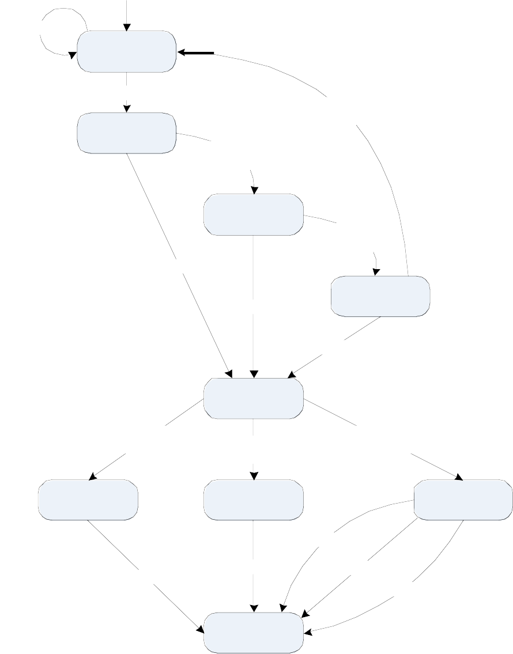
Bad card 0.05
1. Card Entry
Legitimate card 0.95
Incorrect PIN 0.10
2.1 First PIN Try
Incorrect PIN 0.10
2.2 Second PIN Try
Incorrect PIN 0.10
Correct PIN 0.90
Correct PIN 0.90
2.3 Third PIN Try
Correct PIN 0.90
3. Await Transaction
Choice
Button B1 0.05
Button B2 0.10
Button B3 0.85
Balance
Deposit
Withdrawal
Low cash 0.10
1.00
1.00
Normal 0.85
Low balance0.05
Print Receipt

Slide 14
Decomposition of Await PIN State
(PIN Entry FSM)
/ Display Screen S1
Idle
Incorrect PIN
Di
splay Screen S4
Legitimate Card
Wrong Card Display Screen S1,
Eject Card
Display Screen S2
Awaiting First
PIN Try
Incorrect PIN Display Screen S3
Awaiting Second PIN Try
Incorrect PIN Display Screen S3
Correct PIN Display Screen S5
Correct PIN
Awaiting Third PIN Try
Display Screen S5
Await Transaction Choice
Correct PIN Display Screen S5

Slide 15
PIN Try finite state machine
2.x.1
0 Digits Received
x7
(PIN Try x)
Port Input Events digit
cancel
cancel
digit / echo 'X---'
x1
2.x.2
1 Digit Received
cancel
x8
Port Output Events echo 'X---'
echo 'XX--' echo 'XXX-' echo 'XXXX'
digit / echo 'XX--'
x2
2.x.3
2 Digits Received
cancel
2.x.6
Cancel Hit
x9
x3
Logical Output Events Correct PIN Incorrect PIN Canceled
digit / echo 'XXX-'
2.x.4
3 Digits Received
cancel
x10
x11
digit / echo 'XXXX'
x4
2.x.5
4 Digits Received
Cancelled
Correct Pin
x5
Incorrect Pin x6

Slide 16
Deriving An ASF Test Case
Description: Correct PIN on First Try Port Event Sequence in PIN Try FSM
Port Input Event Port Output Event
Screen 2 displayed with '----'
pressed
Screen 2 displayed with 'X---'
pressed
Screen 2 displayed with 'XX--'
pressed
Screen 2 displayed with 'XXX-'
pressed
Screen 2 displayed with 'XXXX'
(Correct PIN)
Screen 5 displayed

Slide 17
Deriving An ASF Test Case (cont'd)
Description: Correct PIN on First Try Test operator instructions
Initial Conditions: screen 2 being displayed with no digit echoes
Perform the following sequence of steps:
1. | Verify: | Screen 2 displayed with '----'
2. | Cause: | 1 pressed
3. | Verify: | Screen 2 displayed with 'X---'
4. | Cause: | 2 pressed
5. | Verify: | Screen 2 displayed with 'XX--'
6. | Cause: | 3 pressed
7. | Verify: | Screen 2 displayed with 'XXX-'
8. | Cause: | 4 pressed
9. | Verify: | Screen 2 displayed with 'XXXX'
Post Condition: Screen 5 displayed Test Result: Pass
Fail

Slide 18
Slight Digression: Architecture of an Automated Test Executor
Cause Digit Keypress
Digit Keypress
ATE
Processor
Port Boundary
Harness
Verify screen text
screen
text

Slide 19
Metrics for System Testing
In the PIN Entry ASF, for a given PIN, there are 156 distinct paths from the First PIN Try state to the Await Transaction Choice or Card Entry states in the PIN Entry FSM. Of these, 31 correspond to eventually correct PIN entries (1 on the first try, 5 on the second try, and 25 on the third try); the other 125 paths correspond to those with incorrect digits or with cancel keystrokes.
To control this explosion, we have two possibilities:
pseudo-structural coverage metrics
"true" structural coverage metrics

Slide 20
Pseudo-structural Coverage Metrics
Behavioral models provide "natural" metrics:
Decision Table Metrics:
every condition
every action
every rule
FSM Metrics:
every state
every transition
Petri Net Metrics:
every place
every port event
every transition
every marking
These are pseudo-structural because they are just models of the eventual system.

Slide 21
Pseudo-structural Coverage Metrics for PIN Try
Input Event Sequence 1,2,3,4
1,2,3,5
C 1,C
1,2,C
1,2,3,C
State Sequence
2.x.1, 2.x.2, 2.x.3, 2.x.4, 2.x.5
2.x.1, 2.x.2, 2.x.3, 2.x.4, 2.x.5
2.x.1, 2.x.6
2.x.1, 2.x.2, 2.x.6
2.x.1, 2.x.2, 2.x.3, 2.x.6
2.x.1, 2.x.2, 2.x.3, 2.x.4, 2.x.6
Two test cases yield state coverage
Input Event Sequence
Path of Transitions
1,2,3,4
1,2,3,5
C 1,C
1,2,C
1,2,3,C
x1, x2, x3, x4, x5 x1, x2, x3, x4, x6 x7, x11
x1, x8, x11
x1, x2, x9, x11
x1, x2, x3, x10, x11
All six are needed for transition coverage

Slide 22
Pseudo-structural Coverage Metrics for PIN Entry FSM
Input Event Sequence
State Sequence
1,2,3,4
1,2,3,5,1,2,3,4
1,2,3,5,C,1,2,3,4 C,C,C
How many test cases yield state coverage?
Input Event Sequence
Path of Transitions
1,2,3,4
1,2,3,5,1,2,3,4
1,2,3,5,C,1,2,3,4 C,C,C
How many are needed for transition coverage?

Slide 23
Consequences of Pseudo-structural Coverage Metrics
Combinatoric explosion is controlled
Selecting test cases from the FSM decomposition reduced 156 threads to 10 test cases
Fault isolation is improved
When a "verify" operation fails, use the FSMs to determine:
what went wrong
where it went wrong
when it went wrong
Base information for testing management

Slide 24
SATM System Threads
Insertion of an invalid card. (this is probably the "shortest" system thread)
Insertion of a valid card, followed by three failed PIN entry attempts.
Insertion of a valid card, a correct PIN entry attempt, followed by a balance inquiry.
Insertion of a valid card, a correct PIN entry attempt, followed by a deposit.
Insertion of a valid card, a correct PIN entry attempt, followed by a withdrawal.
Insertion of a valid card, a correct PIN entry attempt, followed by an attempt to withdraw more cash than the account balance.

Slide 25
SATM System Thread Testing
SATM Test Data
ATM | PAN | Expected | Checking | Savings
Card |  | PIN | Balance | Balance
1 | 100 | 1234 | $1000.00 | $800.00
2 | 200 | 4567 | $100.00 | $90.00
3 | 300 | 6789 | $25.00 | $20.00
4 | (invalid)
Port Input Events
Port Output Events
Insert ATM Card (n)
Key Press Digit (n)
Key Press Cancel
Key Press Button B(n)
Insert Deposit Envelope
Display Screen(n,text)
Open Door(dep, withdraw)
Close Door(dep, withdraw)
Dispense Notes (n)
Print Receipt (text)
Eject ATM Card

Slide 26
Thread 1 Test Procedure
Description: invalid card Test operator instructions
Initial Conditions: screen 1 being displayed Perform the following sequence of steps:
1. | Cause: | Insert ATM Card 4
2. | Verify: | Eject ATM Card
3. | Verify: | Display Screen(1, null)
Post Condition: Screen 1 displayed
Test Result:
Pass
Fail

Slide 27
Thread 2 Test Procedure
Description:
valid card, 3 failed PIN attempts
Initial Conditions: screen 1 being displayed Perform the following sequence of steps:
1. | Cause: | Insert ATM Card 1
2. | Verify: | Display Screen(2, '----')
1. | Cause: | Key Press Digit (1)
2. | Verify: | Display Screen(2,'X---')
1. | Cause: | Key Press Cancel
2. | Verify: | Display Screen(2,'----')
1. | Cause: | Key Press Digit (1)
2. | Verify: | Display Screen(2,'X---')
1. | Cause: | Key Press Digit (2)
2. | Verify: | Display Screen(2,'XX--')
1. | Cause: | Key PressCancel
2. | Verify: | Display Screen(2,'----')
1. | Cause: | Key Press Digit (1)
2. | Verify: | Display Screen(2,'X---')
1. | Cause: | Key Press Digit (2)
2. | Verify: | Display Screen(2,'XX--'
1. | Cause: | Key Press Digit (3)
2. | Verify: | Display Screen(2,'XXX-')
1. | Cause: | Key Press Digit (5)
2. | Verify: | Display Screen(2,'XXXX')
3. | Verify: | Display Screen(4, null)
3. | Verify: | Display Screen(1, null)
Post Condition: Screen 1 displayed
Test Result:
Pass
Fail

Slide 28
Thread 3 Test Procedure
Description:
valid card, a correct PIN entry attempt,
followed by a balance inquiry of the checking account. Initial Conditions: screen 1 being displayed
Perform the following sequence of steps:
1. | Cause: | Insert ATM Card 1
2. | Verify: | Display Screen(2, '----')
3. | Cause: | Key Press Digit (1)
4. | Verify: | Display Screen(2,'X---')
5. | Cause: | Key Press Digit (2)
6. | Verify: | Display Screen(2,'XX--'
7. | Cause: | Key Press Digit (3)
8. | Verify: | Display Screen(2,'XXX-')
9. | Cause: | Key Press Digit (4)
10. | Verify: | Display Screen(2,'XXXX')
11. | Verify: | Display Screen(5, null)
12. | Cause: | Key Press Button B(1)
13. | Verify: | Display Screen(6, null)
14. | Cause: | Key Press Button B(1)
15. | Verify: | Display Screen(14,null)
16. | Cause: | Key Press Button B(2)
17. | Verify: | Print Receipt ('$1000.00')
18. | Verify: | Display Screen(15, null)
19. | Verify: | Eject ATM Card
20. | Verify: | Display Screen(1, null)
Post Condition: Screen 1 displayed
Test Result:
Pass
Fail

Slide 29
Thread 4 Test Procedure
Description:
valid card, a correct PIN entry attempt,
followed by a $25.00 deposit to the checking account
Cause:
Verify:
Insert ATM Card 1 Display Screen(2, '----') Key Press Digit (1,2,3,4) Display Screen(2,'XXXX')
3,5,7,9.
Cause: Verify:
4,6,8,10.
11. | Verify: | Display Screen(5, null)
12. | Cause: | Key Press Button B(2)
13. | Verify: | Display Screen(6, null)
14. | Cause: | Key Press Button B(1)
15. | Verify: | Display Screen(7, '$----.--')
16. | Cause: | Key Press Digit (2)
17. | Verify: | Display Screen(7, '$----.-2')
18. | Cause: | Key Press Digit (5)
19. | Verify: | Display Screen(7, '$----.25')
20. | Cause: | Key Press Digit (0)
21. | Verify: | Display Screen(7, '$---2.50')
22. | Cause: | Key Press Digit (0)
23. | Verify: | Display Screen(7, '$--25.00'
24. | Verify: | Display Screen(13, null)
25. | Verify: | Open Door(deposit)
26. | Cause: | Insert Deposit Envelope
27. | Verify: | Close Door(deposit)
28. | Verify: | Display Screen(14, null)
29. | Cause: | Key Press Button B(2)
30. | Verify: | Print Receipt ('$1025.00')
31. | Verify: | Display Screen(15, null)
32. | Verify: | Eject ATM Card
33. | Verify: | Display Screen(1, null)
Post Condition: Screen 1 displayed
Test Result:
Pass
Fail

Slide 30
Thread 5 Test Procedure
Description: valid card, a correct PIN entry attempt, followed by an attempt to withdraw more cash than the savings account balance.
Cause:
Verify:
Insert ATM Card 2 Display Screen(2, '----') Key Press Digit (4,5,6,7) Display Screen(2,'XXXX')
3,5,7,9.
Cause: Verify:
4,6,8,10.
11. | Verify: | Display Screen(5, null)
12. | Cause: | Key Press Button B(3)
13. | Verify: | Display Screen(6, null)
14. | Cause: | Key Press Button B(2)
15. | Verify: | Display Screen(7, '$----.--')
16,18,20,22,24 |  | Cause: | Key Press Digit (1,1,0,0,0)
17,19,21,23,25 |  | Verify: | Display Screen(7, '$-110.00')
24. | Verify: | Display Screen(8, '----.--')
26. | Cause: | Key Press Cancel
28. | Verify: | Display Screen(14, null)
29. | Cause: | Key Press Button B(2)
30. | Verify: | Print Receipt ('$90.00')
31. | Verify: | Eject ATM Card
32. | Verify: | Display Screen(1, null)
Post Condition: Screen 1 displayed
Test Result:
Pass
Fail

Slide 31
Operational Profiles
Zipf's Law: 80% of the activities occur in 20% of the space
productions of a language syntax
natural language vocabulary
menu options of a commercial software package
area of an office desktop
floating point divide on the Pentium chip
For Threads: a small fraction of all possible threads represents the majority of system execution time.
Therefore: find the occurrence probabilities of threads and use these to order thread testing.

Slide 32

Operational Profiles of SATM
Bad card 0.05
1. Card Entry
Legitimate card 0.95
Incorrect PIN 0.10
2.1 First PIN Try
Common Thread | Probabilities
Legitimate Card | 0.95
PIN ok 1st try | 0.90
Withdraw | 0.85
Normal | 0.85
 | 0.6177375
Incorrect PIN 0.10
2.2 Second PIN Try
Incorrect PIN 0.10
Correct PIN 0.90
Correct PIN 0.90
2.3 Third PIN Try
Rare Thread Legitimate Card Bad PIN 1st try Bad PIN 2nd try PIN ok 3rd try Withdraw
Low Cash
Probabilities 0.95
0.10
0.10
0.90
0.85
0.01
0.00072675
Correct PIN 0.90
3. Await Transaction
Choice
Button B1 0.05
Button B2 0.10
Button B3 0.85
Balance
Deposit
Withdrawal
Low cash 0.10
1.00
1.00
Normal 0.85
Low balance0.05
Print Receipt

Slide 33
SATM Atomic System Functions
ASF1: Examine ATM Card
Inputs:
PAN from card, List of acceptable cards
Outputs: Legitimate Card, Wrong Card ASF2: Control PIN Entry
Inputs: Expected PIN, Offered PIN
Outputs: PIN OK, Wrong PIN
ASF3: Get Transaction Type
Inputs: Button1, Button2, or Button3 depressed Outputs: call Get Account Type (not externally visible)
ASF4: Get Account Type
Inputs: Button1 or Button2 depressed
Outputs: call one of Process Withdrawal, Process Deposit, or Display Balance (not externally visible)
ASF5: Process Withdrawal
Inputs:
Amount Requested, Cash Available, Local Balance
Outputs: Process Request (call Dispense Cash)
Reject Request (insuficient funds or insuficient balance)

Slide 34
SATM Atomic System Functions
ASF6: Process Deposit
Inputs:
Deposit Amount , Deposit Envelope, Deposit Door Status, Local Balance
Outputs: Process Request (call Credit Local Balance) Reject Request
ASF7: Display Balance
Inputs: Local Balance Outputs: (call Screen Handler)
ASF8: Manage Session
Inputs: New Transaction Requested, Done
Outputs: (call Get Transaction Type or call Print Receipt)
ASF9: Print Receipt
Inputs:
Account Number, transaction type and amount, new local balance, time, date
Outputs: formatted text for receipt, (call Eject Card) ASF10: Eject Card
Inputs: (invoked)
Outputs: (control rollers)

Slide 35
"Hidden" Atomic System Functions
ASF11: Dispense $10 Note ASF12: Screen Handler ASF13: Button Sensor ASF14: Digit Keypad Sensor ASF15: Cancel Sensor ASF16: Card Roller Controller ASF17: Control Deposit Door
ASF18: Control Deposit Rollers ASF19: Control Cash Door ASF20: Count Cash on Hand ASF21: Timer

Slide 36
Thread 1: | Wrong Card | SATM Threads
 | State Sequence: Event Sequence: ASF Sequence: | Idle, Idle Display Screen 1, Wrong Card
Thread 2: | Wrong PIN State Sequence: | Idle, Await 1st PIN Try, Await 2nd PIN Try, Await 3rd PIN Try,
 | Event Sequence: ASF Sequence: | Idle Display Screen 1, Legitimate Card, Wrong PIN, Wrong PIN, Wrong PIN, Display Screen 4, Display Screen 1
Thread 3: | Balance Inquiry State Sequence: | Idle, Await 1st PIN Try, Acquire Transaction Data, Display
 | Event Sequence: ASF Sequence: | Balance, Display Balance, Close Session, Idle Display Screen 1, Legitimate Card, Wrong PIN, Wrong PIN, Wrong PIN, Display Screen 4, Display Screen 1

Slide 37
SATM Threads
Thread 4:
Balance then Deposit then Withdraw
State Sequence: Idle, Await 1st PIN Try, Acquire Transaction Data, Display Balance, Close Session, Acquire Transaction Data, Process Deposit, Close Session, Acquire Transaction Data, Process Withdrawal, Close Session, Idle
Event Sequence: Display Screen 1, Legitimate Card, Wrong PIN, Wrong PIN, Wrong PIN, Display Screen 4, Display Screen 1
ASF Sequence:
Thread 5:
3 PIN Tries then Balance then Deposit then Withdraw
State Sequence: Idle, Await 1st PIN Try, Await 2nd PIN Try, Await 3rd PIN Try, Acquire Transaction Data, Display Balance, Close Session, Acquire Transaction Data, Process Deposit, Close Session, Acquire Transaction Data, Process Withdrawal, Close Session, Idle
Event Sequence: Display Screen 1, Legitimate Card, Wrong PIN, Wrong PIN, Wrong PIN, Display Screen 4, Display Screen 1
ASF Sequence:

Slide 38
ATM States and Transitions
S1
t5
t1
t2
t3
t4
S4
t16
S2
S3
t6
t7
t8
S5
t9
t10
t11
S6
S7
S8
t12
t13
t14
t15
S9

